Slide 1
“You can Compress!!!”
Dimensionality Reduction - Why? What? How?
By :- Manan Pal Singh, NSIT
Nilay Shrivastava, NSIT
Notes:
Manan Singh
Nilay Shrivastava

Slide 2

Speakers
Manan Pal Singh
CS undergrad at NSIT Delhi
Interest domains: Computer Vision, Web Security, Cryptography, Mathematics.
Past-time hobby: Solving math problems, reading AI and security blogs.
My motive is to contribute to the progress in the AI field, and working on some missing theories in the field to develop a better understanding.

Slide 3
Speakers
Nilay Shrivastava
CS undergrad at NSIT Delhi.
Interest domains: Mathematics, Physics and Computer Science.
Past-time hobby: Read about Modern Physics and AI.
Keenly interested in the theoretical foundations of AI.
My dream is to be a part of the community of people working to solve intelligence.

Slide 4
What lies ahead?
“An awesome presentation of course” - Aristotle
What is dimensionality reduction, why do we need it
Diving into PCA (basic intuition and formulation)
Inside t-SNE
Autoencoders
When to use what

Slide 5

What is dimensionality reduction?

Slide 6
Dimensionality Reduction (D.R)
D.R is the process of reducing the degrees of freedom of given dataset.
In other words expressing some information (in this case dataset) in the most compact way without any significant loss of content (information).
The ‘information’ is described using a fixed number of variables. We intend to reduce this number (of variables).

Slide 7
What are the Variables?
Variables are the features of the dataset.
Every entry of the dataset is uniquely defined by a certain combination of these variables.
Just like a point in Cartesian Geometry, we can treat these features as co-ordinates of dataset ‘space’.
N-feature dataset => n co-ordinates => n dimensions

Slide 8

Why Dimensionality Reduction
“Why on earth will anyone do that???” - Galileo

Slide 9
Reasons
To dilute the ‘curse of dimensionality’
Reduce the computational complexity
Reduce sparsity
For feature extraction
For Visualization
D.R algorithms to reduce the dimensions to 2 or 3 for human visualisation
Necessary for debugging/understanding data algorithms and datasets themselves.

Slide 10
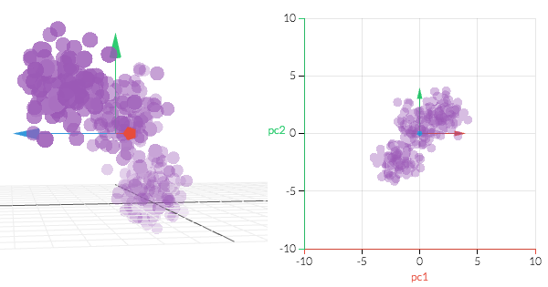
Principle Component Analysis
“WTF does that mean?” - DJ Trump

Slide 11
Basic Intuition Behind PCA
PCA can be thought of as the process of choosing an appropriate set of axes. (Similar to what we do while solving Physics problems)
We rotate our original axes and then drop the component(s) on which the projection of our data-points is small
The above process is performed so that there is little loss of information.
The axes are chosen in a way such that the maximum variance in data is retained
Of course the number of axes selected is less than the original dimension.

Slide 12
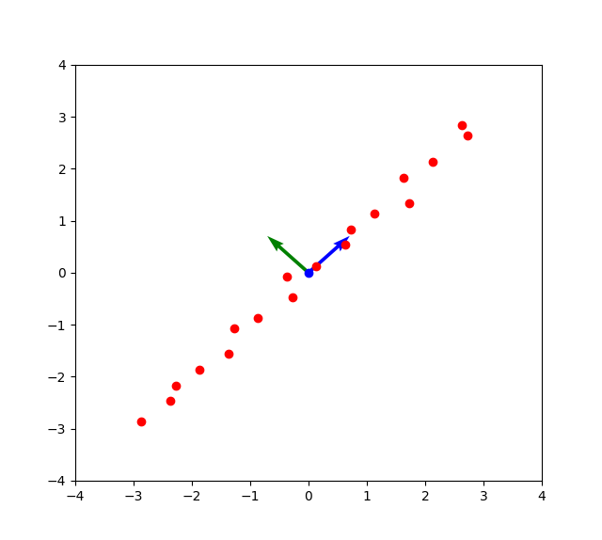
A small visualisation to the rescue!!
The red dots are the data points (of a 2D dummy dataset)
The blue and green arrows are the rotated axes.
Finally we will drop the green arrow and represent data as projection on the blue arrow (principal component)

Slide 13
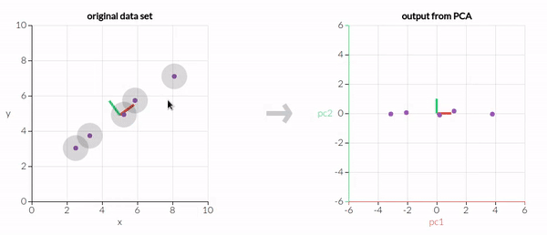

Slide 14
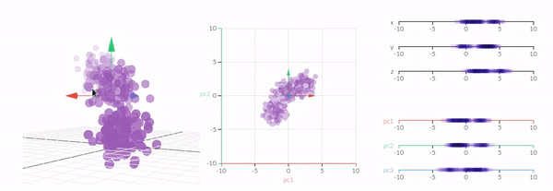

Slide 15
So how to calculate these directions?
Decide how many dimensions to compress your data (say k) into.
Calculate the “eigenvectors” of the “covariance” matrix of the dataset.
Sort the eigenvectors in the decreasing order of their “eigenvalues”.
Choose the top k eigenvectors (These are your new axes).
Project your data-points on these eigenvectors.

Slide 16
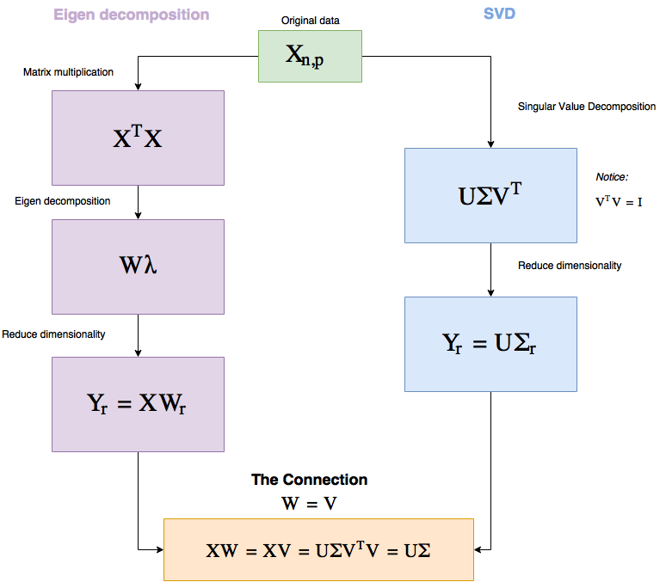

Slide 17
Isn’t this looking eerily similar to Linear Regression?
Both PCA and Linear Regression are framed as Optimization problems.
Both try to minimize the mean squared loss.
Loss function of PCA :- “Find the axes for which the sum of squared distance of data-points from these axes is minimum.”
The algorithm is actually the solution of this optimization.

Slide 18
Some Points on pca
Deterministic
Apply the algorithm on same dataset any number of times, will get the same output.
Technically PCA is returning a function.
Computation:
Efficient with linear algebra libraries like Numpy, LAPACK, Eigen.
Visualisation:
Preserves variance of the dataset.
Good for linearly correlated datasets.
Local neighbourhood isn’t preserved to a large extent (clustering not apparent).

Slide 19

t-SNE
T-distributed Stochastic Neighborhood Embedding

Slide 20

Why t-SNE?
t-SNE specializes in preserving local neighbourhood relation. (Methods like PCA don’t).
t-SNE visualisation is therefore one of the best for clustered datasets
One can tune t-SNE parameters to fit the visualisation according to need.

Slide 21
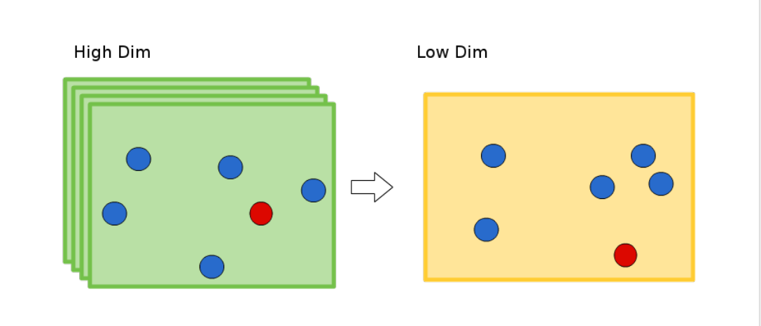
Local Neighbourhood Problem
Neighbourhood relations (clusters) may or may not be maintained.
This is a common issue in PCA when applied to categorical data.

Slide 22
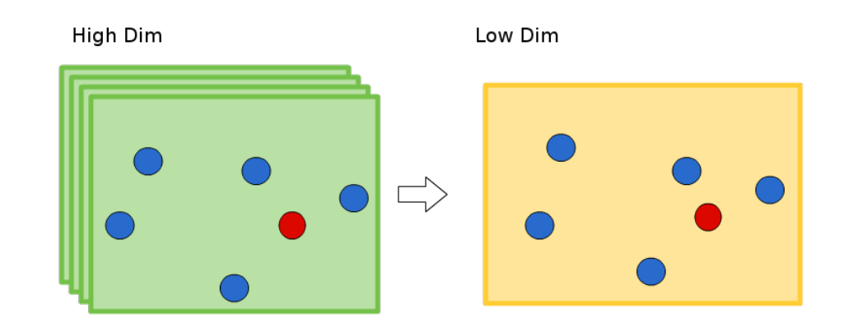
Preserving the Neighbourhood relationship
That’s what we want!!!

Slide 23
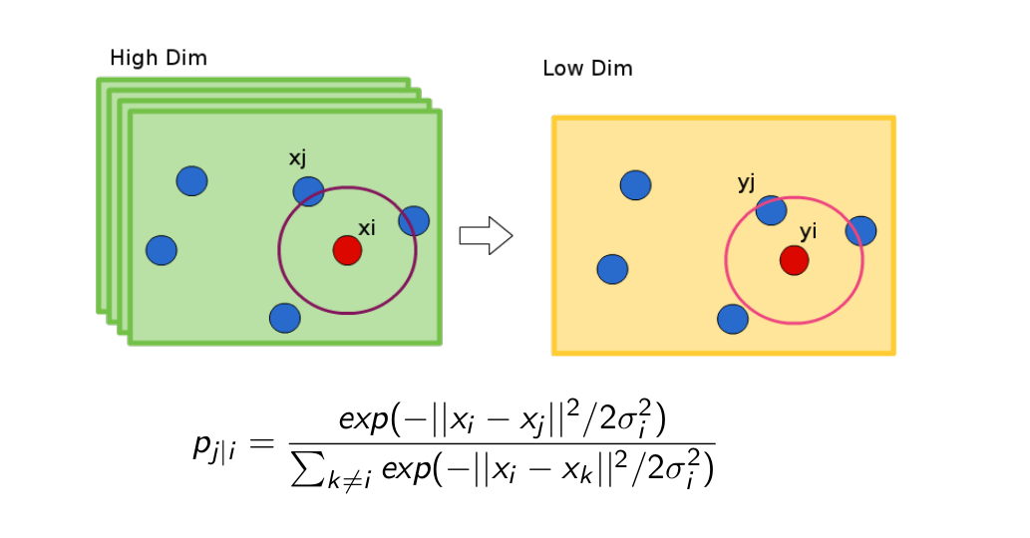
How t-SNE solves it
t-SNE creates a gaussian based probability distribution in high dimension giving the probability ‘p’ that a data point i selects another data point j.

Slide 24
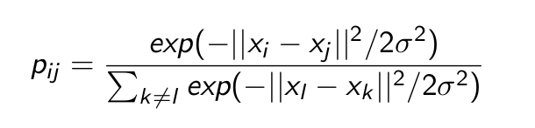
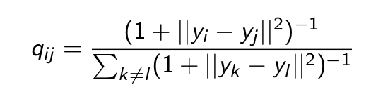
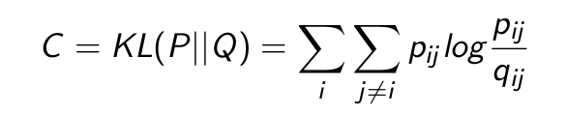
.. continued
It creates a similar distribution for low dimension. Therefore
Similarity in higher dimension
Similarity in lower dimension
Here y’s are the lower dimensions representations that are learned using gradient descent.
The cost function is the KL(p||q)

Slide 25
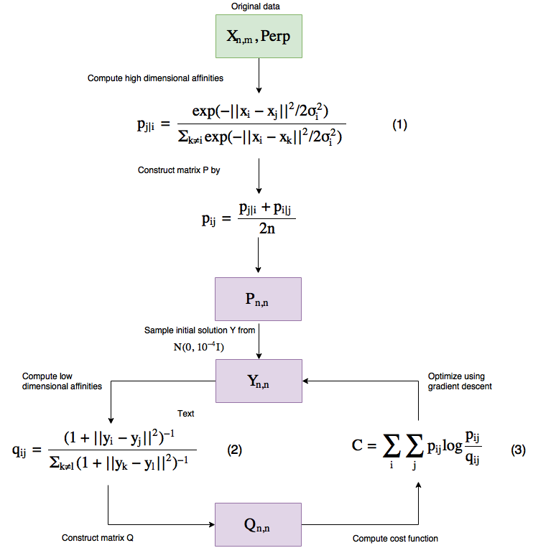

Slide 26
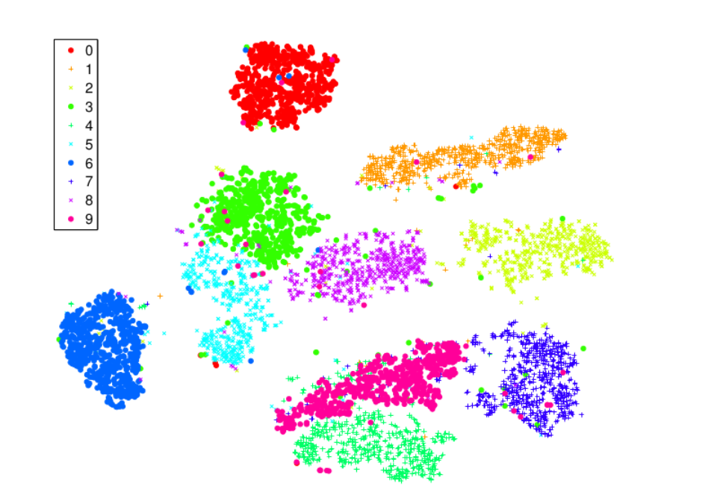
Results on mnist (t-SNE)
t-SNE

Slide 27
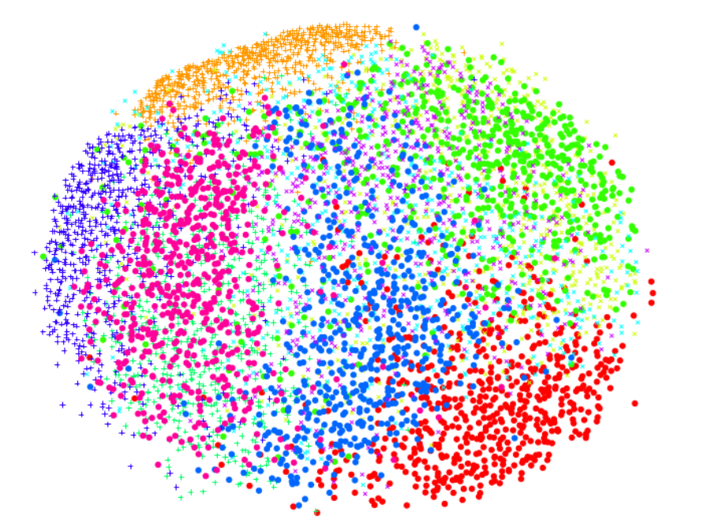
Results on MNIST (PCA)

Slide 28
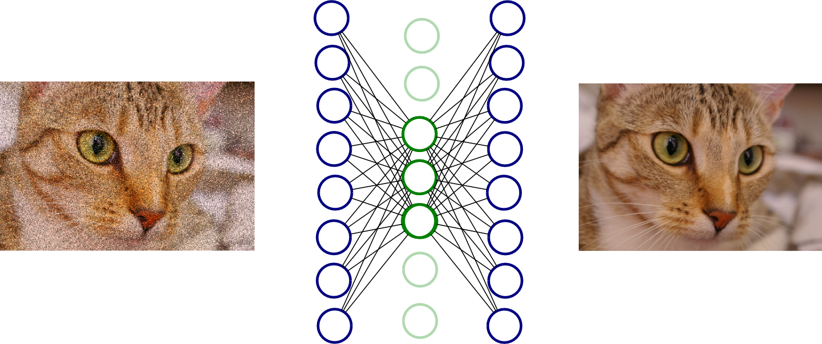
Auto-Encoder

Slide 29
Autoencoders
Simplest encoder-decoder models.
Train a 1-(hidden) layer Neural Network to learn the Identity function
Give x as input, and the network to give x as output
The input and output layer are of same size.
The middle layer is (considerably) smaller.
After training we remove the output (decoder) and use the input to project the data to smaller dimension.

Slide 30

Like This ...

Slide 31
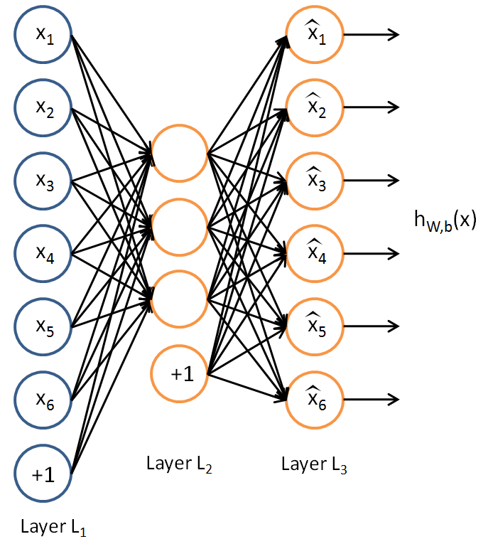
By constraining the size of the hidden layer, we force the autoencoder to learn efficient representation of the data.
Interestingly the autoencoder projection to latent space is similar to PCA.

Slide 32
When should You Use Autoencoders?
Autoencoders are used for denoising images.
Project your data to auto-encoder latent space and use it for nearest neighbour classification.
Forcibly making a neural network to learn hidden representation ensures that the latent space projections have less redundancy and are a better representation of data, use this as input for SVMs or any other algorithm.

Slide 33
Looking Ahead

Slide 34
Rule(s) of thumb ...
Use t-SNE for visualisation.
Use PCA for cases where deterministic solutions are desirable.
Use PCA when it is known that there exists some correlation in data.
Use PCA for new unseen data in a given problem.
PCA provides the eigenvectors for projection.
No such framework present in t-SNE.

Slide 35
This is not the end
There are other algorithms like Linear Discriminant Analysis, Generalized Discriminant Analysis.
Using Convolutional Neural Networks as feature extractors (like autoencoders).
Using autoencoders as a lossy compression algorithm.

Slide 36
Thank You!!!

